Slide 1
From Data Fusion to Knowledge Fusion
Xin Luna Dong, Google Inc.

Slide 2






Knowledge Is Power
Many Knowledge Bases (KB)
Notes:
Nowadays, a lot of knowledge bases have appeared.
Unlike the manually created knowledge bases such as WordNet or FrameNet,
These knowledge bases always use information extraction techniques to extract knowledge from large Web sources.

Slide 3
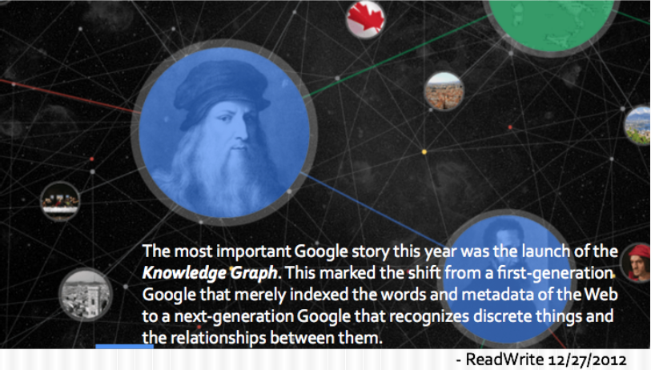
Google Knowledge Graph
Notes:
There is a news,

Slide 4
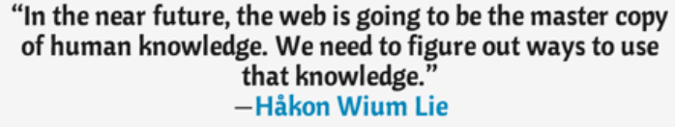
Expanding KG– Extracting Knowledge from the Web
But-
KG requires 99% accuracy for Knowledge
Web data is noisy and extraction is hard
How to balance coverage and accuracy?
Notes:
To expanding the Knowledge bases, we need Extracting Knowledge from the Web.
Mainly because, the web is going to be the master copy of human knowledge.
But,

Slide 5
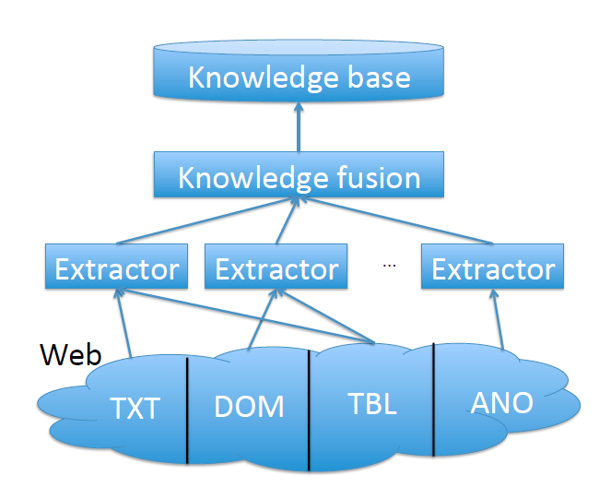
Building a Probabilistic KB
Notes:
This is an architecture of building a knowledge base.
First, we should extract information from different Web sources.
But the information extracted may contain a lot of noises and errors.
Then we need a step for knowledge fusion.
Finally, we get the knowledge base.

Slide 6
Outline
Knowledge extraction
Knowledge fusion
Interesting applications

Slide 7
Outline
Knowledge extraction
Knowledge fusion
Interesting applications

Slide 8
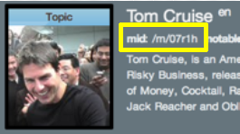
Knowledge Extraction I–Knowledge
Triple: (subject, predicate, object)
e.g., (Tom Cruise, date_of_birth, 7/3/1962)
Subject–a Freebase mid (e.g., /m/07r1h)
Predicate–predefined in Freebase (e.g., people/person/date_of_birth)
Object–a Freebase mid, a string, a number, or a date.
Notes:
In this paper the authors follow the data format and ontology in Freebase,
which contains a large number of manually verified triples.

Slide 9
Statistics for Extracted Triples
A large knowledge base
Highly skewed data–fat heads, long tail
#Triples per type: 1–14M
#Triples per entity: 1–2M
#Triples | 1.6B
#Subjects (Entities) | 43M
#Types | 1.1K
#Predicates | 4.5K
#Objects | 102M
Notes:
In this paper we focus on triples whose subjects and predicates already exist in Freebase.
Our goal is to extract new facts about these subjects and predicates.
For each extracted triple, we keep rich provenance information,
including which extractor was used to extract it, which URL the triple is extracted from, and so on.
The distributions are highly skewed, which mean they have a heavy head and a long tail.

Slide 10
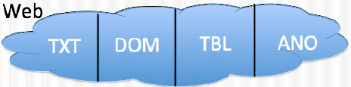
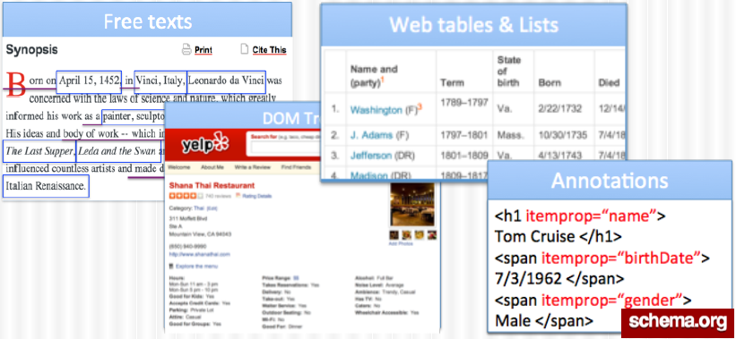
Knowledge Extraction II–Sources
Notes:
We crawl a large set of Web pages and extract knowledge from four types of Web contents.
Text documents (TXT) contain texts from Web pages.
DOM trees (DOM) contain information organized in DOM-tree format, which can be found either in Web pages.
Web tables (TBL) contain tabular data on the Web with essentially relational data.
Finally, Web annotations (ANO) contain annotations manually created by Webmasters.

Slide 11
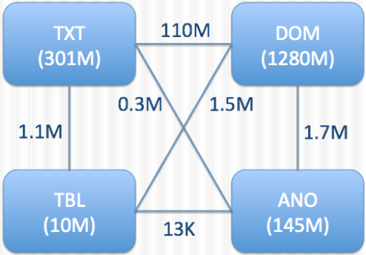
Statistics for Web Sources
1B+ Webpages over the Web
#Triples extracted from each type of Web contents
Notes:
DOM is the largest contributor and contributes 80% of the triples,
while TXT comes next and contributes 19% of the triples.
We may extract the same triple from different types of Web
contents; but interestingly, the overlap is rather small.

Slide 12
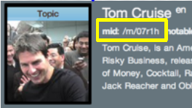
Knowledge Extraction III–Extractors
Three tasks (any order, maybe combined)
Triple identification
Entity linkage
Predicate linkage
/people/person/date_
of_birth
Notes:
We employ a variety of extractors that extract knowledge triples from the Web.
And commonly, there are three tasks in knowledge extraction.

Slide 13
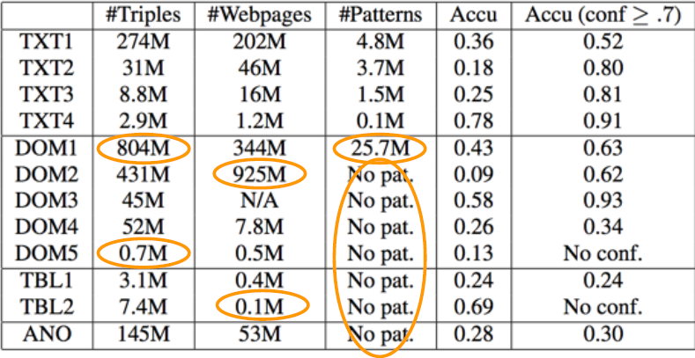
Statistics for Extractors
12 extractors; high variety
Notes:
We observe a high variety in the number of unique triples extracted by each extractor,
and in the number of the Webpages each extractor extracts triples from.

Slide 14

Errors Can Creep in at Every Stage
Errors can creep in at every stage in this process, not only from the Web sources, but also from triple identification, entity linkage, and predicate linkage by the extractors.
Notes:
Some of the erroneous triples are due to wrong information provided by Web sources
whereas others are due to mistakes in extractions

Slide 15
Knowledge Extraction IV–Quality
Gold standard: Freebase
LCWA (Local Closed-World Assumption)
If (s,p,o) exists in FB: true
Otherwise,
If (s,p) exists in FB: false (Freebase knowledge is locally complete)
Otherwise: UNKNOWN
40% of the triples have gold standard labels
650M/1.6B triples
Notes:
In this paper they use Freebase as gold standard.
Since its triples are manually verified and thus highly reliable.
To evaluate the quality, we make a such assumption,
which we call the local closed world assumption (LCWA).
And among the 1.6B triples, 650M (40%) have gold standard labels.

Slide 16
Statistics for Triple Correctness
Overall accuracy: 30%
200M/650M triples
Assume that the accuracy of triples not in the gold standard is similar to those in the gold standard.
Random sample on 25 false triples
Triple-identification errors: 11 (44%)
Entity-linkage errors: 11 (44%)
Predicate-linkage errors: 5 (20%)
Source-data errors: 1 (4%)
Extractions are responsible for the majority of the errors.
Notes:
For Statistics, among the 1.6B triples, 650M (40%) have gold standard labels,
of which 200M are labeled as correct.
In other words, the accuracy of the extracted triples is estimated to be about 30%.
Assume that the accuracy of triples not in the gold standard is similar to those in the gold standard.

Slide 17
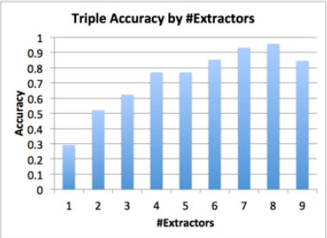
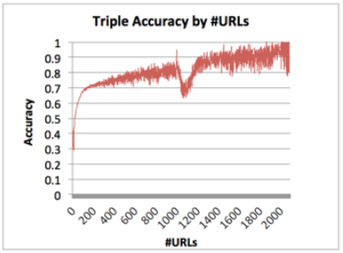
Statistics for Triple Correctness
The more Web sources from which we extract a triple, or the more extractors that extract a triple, the more likely the triple is true.
Notes:
As shown in this two tables,
the more Web sources from which we extract a triple,
or the more extractors that extract a triple,
the more likely the triple is true.

Slide 18
Outline
Knowledge extraction
Knowledge fusion
Interesting applications

Slide 19
Goal: Judge Triple Correctness
Input: Knowledge triples and their provenances (i.e., which extractor extracts from which source)
Output: a probability in [0,1] for each triple
High pr→ KG
Medium pr→ active learning
Low pr→ Negative training examples
Notes:
We can use such probabilistic knowledge in three ways.
For the triples with very high probabilities, we can trust them and use them directly in applications.
For the triples with very low probabilities, we can feed them to extraction systems as negative training examples.
The triples with medium probabilities can be used as input to active learning strategies

Slide 20
Definition
(KNOWLEDGE FUSION).
Given a set of extracted knowledge triples, each associated with provenance information such as the extractor and the Web source, knowledge fusion computes for each unique triple the probability that it is true.

Slide 21
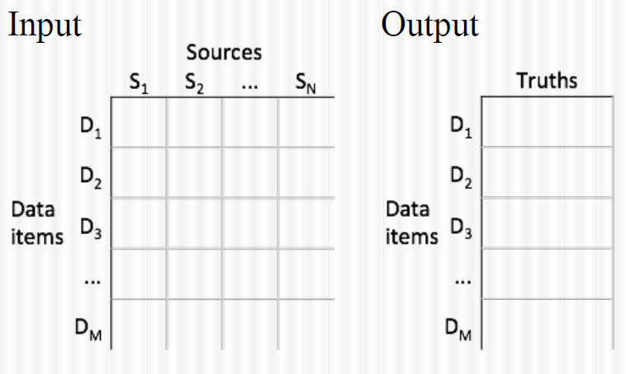
Data Fusion–Definition
Notes:
Assume we have M data items, each describing a particular aspect of an entity
(e.g., the date of birth of Tom Cruise), and N data sources (e.g., Web sites);
We can visualize the raw data as an M*N data matrix,
where each cell represents the values provided by a source on a data item.
The goal is to infer the true value for each of the data items (rows).

Slide 22
Data Fusion–Intuition
 | Src1 | Src2 | Src3
Jagadish | UM | ATT | UM
Dewitt | MSR | MSR | UW
Bernstein | MSR | MSR | MSR
Carey | UCI | ATT | BEA
Franklin | UCB | UCB | UMD

Slide 23
Data Fusion–Intuition
 | Src1 | Src2 | Src3
Jagadish | UM | ATT | UM
Dewitt | MSR | MSR | UW
Bernstein | MSR | MSR | MSR
Carey | UCI | ATT | BEA
Franklin | UCB | UCB | UMD
Voting--Trust the majority

Slide 24
Data Fusion–Intuition
 | Src1 | Src2 | Src3
Jagadish | UM | ATT | UM
Dewitt | MSR | MSR | UW
Bernstein | MSR | MSR | MSR
Carey | UCI | ATT | BEA
Franklin | UCB | UCB | UMD
Quality-based--Give higher votes to more
knowledgeable sources.

Slide 25
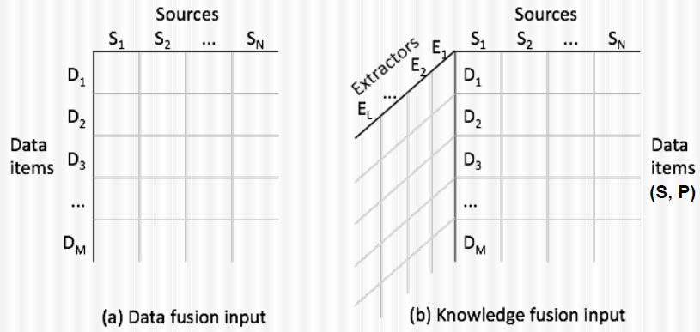
Knowledge Fusion Definition
Cell: a triple
Input is three-dimensional
Notes:
For Knowledge Fusion, the input is three-dimensional.
And we can regard an data item as a pair of (subject, predicate).
The cell value represents a triple.

Slide 26
Knowledge Fusion Solutions
Reduce the dimension of the KF input by considering each (Extractor, URL) pair as a data source, which we call a provenance.
Voting – baseline
Quality-based
MapReduce Based Framework

Slide 27
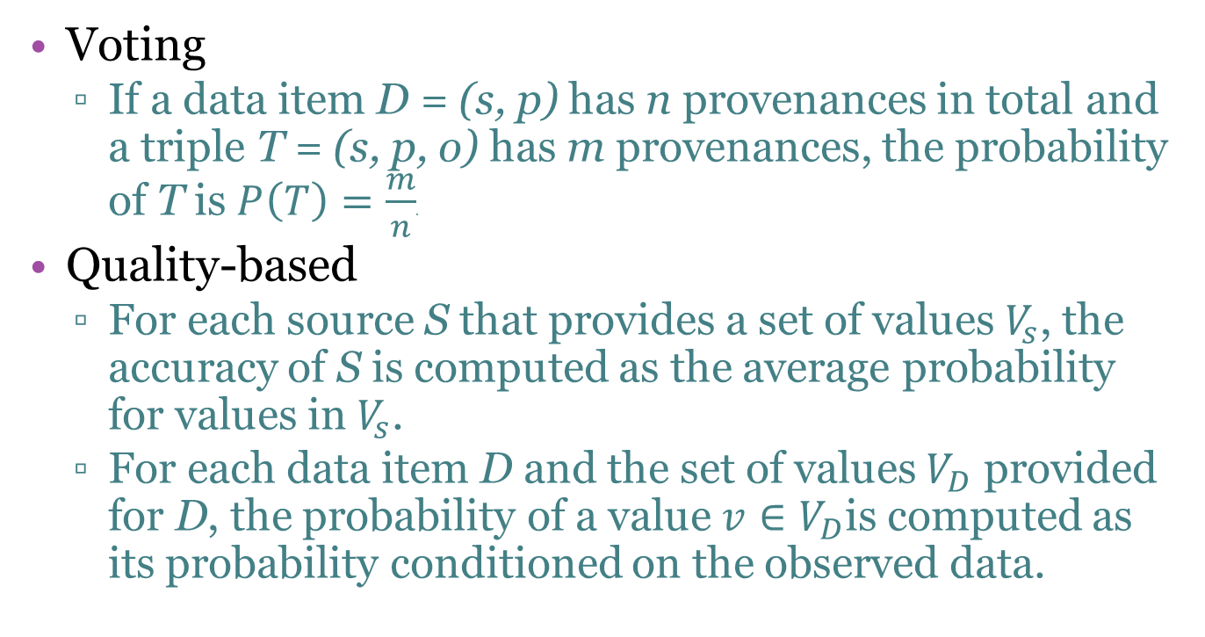
Knowledge Fusion Solutions
Voting
If a data item D = (s, p) has n provenances in total and a triple T = (s, p, o) has m provenances, the probability of T is $P\left(T\right)=\frac{m}{n}$.
Quality-based
For each source S that provides a set of values $V_{s}$, the accuracy of S is computed as the average probability for values in $V_{s}$.
For each data item D and the set of values $V_{D}$ provided for D, the probability of a value $v∈V_{D}$is computed as its probability conditioned on the observed data.

Slide 28
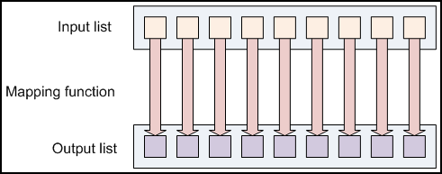
Addition? MapReduce
(Key, Value) pairs

Slide 29
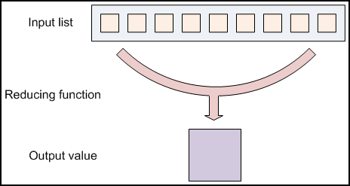
Addition? MapReduce

Slide 30
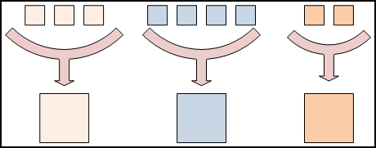
Addition? MapReduce
The same key
The same key
The same key

Slide 31
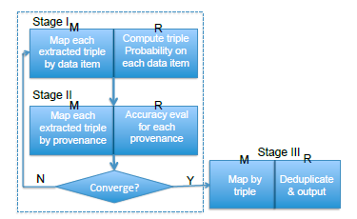
Knowledge Fusion Solutions
MapReduce Based Framework

Slide 32
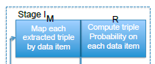
MapReduce Based Framework
In the first stage:
The Map step takes as input the extracted triples, each being a (triple, provenance) pair, and partitions them by the associated data item (Sub, Pred) pair;
The Reduce step computes the probability on all triples provided for the same data item.

Slide 33
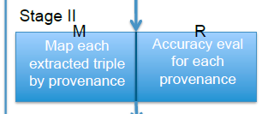
MapReduce Based Framework
In the second stage:
The Map step partitions each extracted triple, where the triple is already assigned a probability, by its provenance;
The Reduce step computes the accuracy of each provenance from its triples.

Slide 34
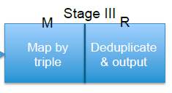
MapReduce Based Framework
In the third stage:
The Map step partitions extracted triples by the triple;
The Reduce step removes duplicates from different provenances.

Slide 35
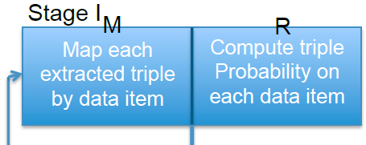
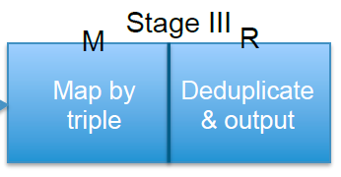
MapReduce Based Framework
Note that voting does not need the iterations and has only Stage I and Stage III.

Slide 36
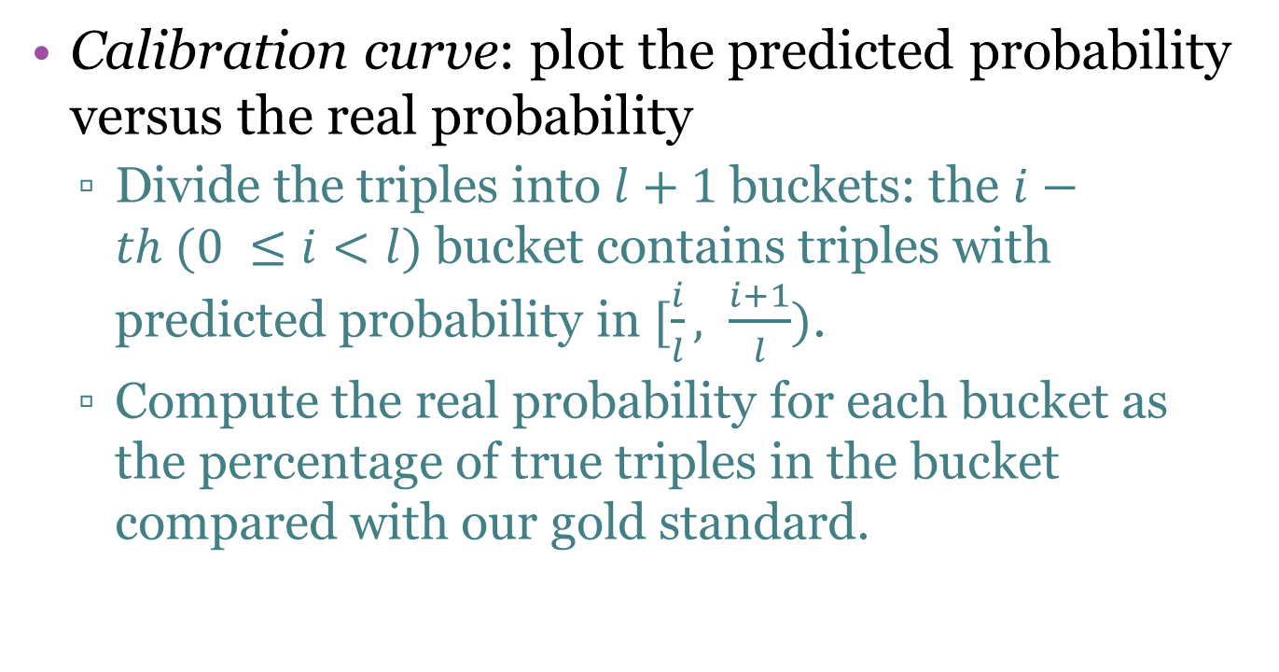
Knowledge Fusion Evaluation
Calibration curve: plot the predicted probability versus the real probability
Divide the triples into $l+1$buckets: the $i−th (0 ≤i<l)$ bucket contains triples with predicted probability in $[\frac{i}{l}, \frac{i+1}{l})$.
Compute the real probability for each bucket as the percentage of true triples in the bucket compared with our gold standard.

Slide 37
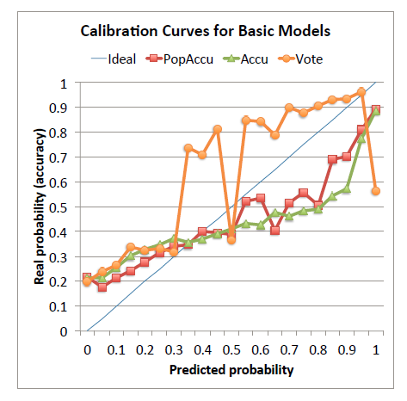
Knowledge Fusion Evaluation
The ideal curve is a diagonal line from (0,0) to (1,1).

Slide 38
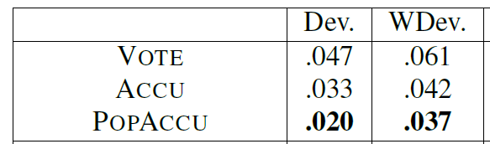
Knowledge Fusion Evaluation
Summarize the calibration using two measures:
The deviation computes the average square loss between predicted probabilities and real probabilities for each bucket.
The weighted deviation is the same except that it weighs each bucket by the number of triples in the bucket.

Slide 39
Outline
Knowledge extraction
Knowledge fusion
Interesting applications

Slide 40
Application I. A New Angle to Evaluate Web Source Quality
Goal: Evaluate trustworthiness of sources by the correctness of its information.

Slide 41
Application II. Provide An X-Ray for Extracted Data
Goal: Help users analyze errors, changes and abnormalities in data.

Slide 42
Thank you!

